Slide 1


Peer-2- Pocket Monsters
Riley Abrahamson, Alexandra Burress, Huan Ho
Notes:
BRIEFLY INTRODUCE YOUR group members

Slide 2

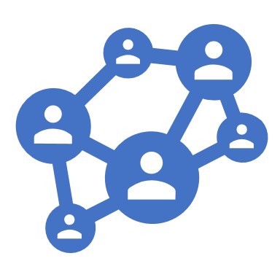


Introduction
Our project is a Peer-to-Peer, Pokémon battle web application
User can connect to another user via ID. Once connected, they can battle with each other
Each Pokémon will have 4 different moves that users take turn choosing to interact
Users can also chat during their battle

Slide 3
Tools Used
HTML5/SCSS/JavaScript
Framework-less
PeerJS
Actual Pokemon Games
A TON of Assets and Custom Styling

Slide 4
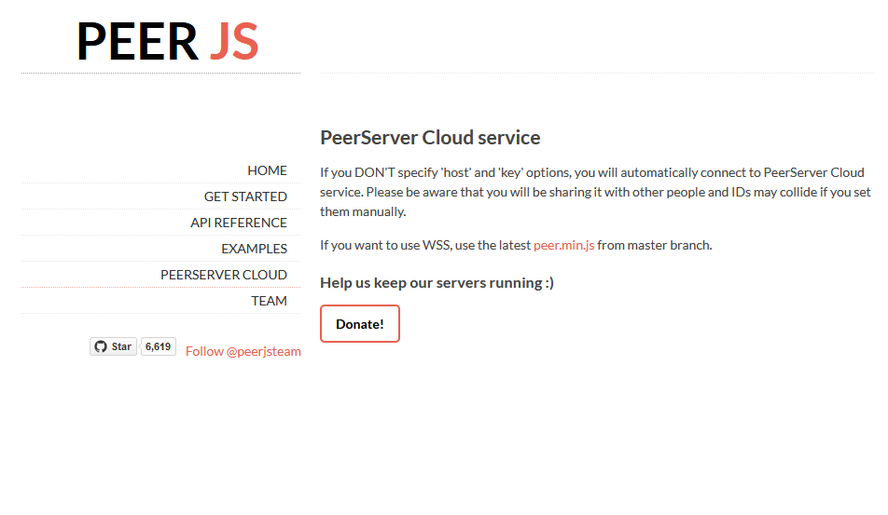
What is PeerJS?
PeerJS is a JavaScript library that allows two web browser to connect to other another without a server* to send asynchronous data back and forth.

Slide 5
How does PeerJS Work?
Sender
Receiver

Slide 6
How does PeerJS Work?
PeerJS Provided Server
Sender
Receiver

Slide 7
How does PeerJS Work?
Sender
Receiver

Slide 8
How does PeerJS Work?
Conn.send()

Slide 9
How does PeerJS Work?
Conn.send()
[code, value]

Slide 10
How does PeerJS Work?
Conn.send()
Code | Meaning
0 | Load Monsters
1 | Chat
2 | Attack
3 | -
4 | -
5 | -
6 | -
7 | -
8 | Start Battle
9 | End Battle
[code, value]

Slide 11
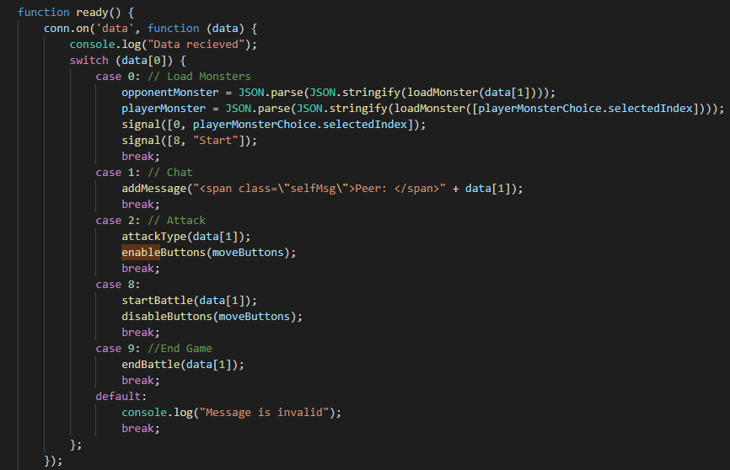
How does PeerJS Work?
Conn.send()
[code, value]

Slide 12
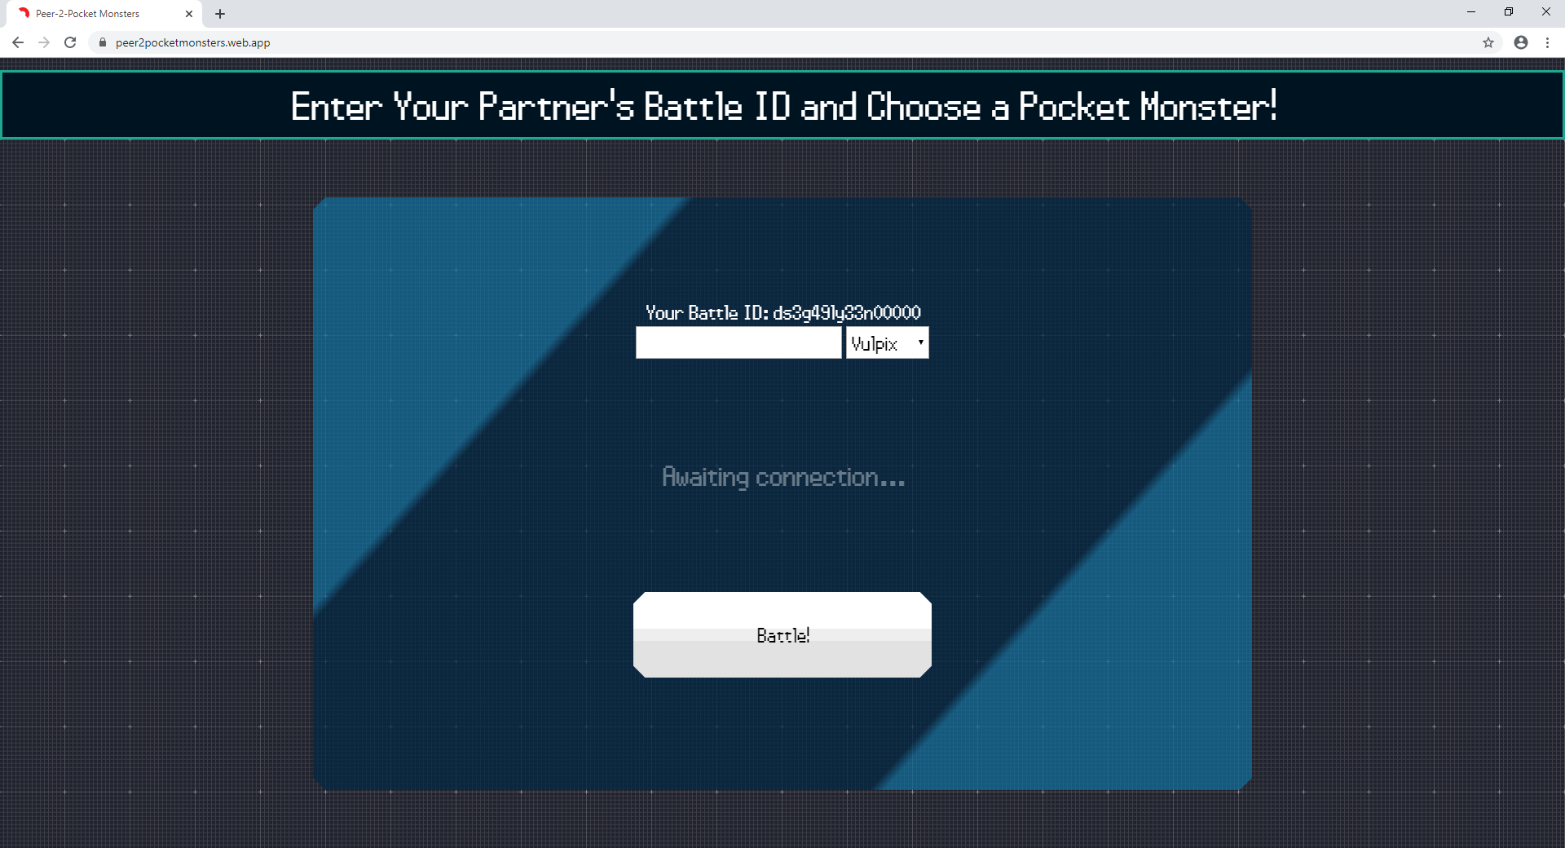
Well, what does it look like?

Slide 13
https://peer2pocketmonsters.web.app/

